Slide 1
A Facilitator's Story:
An ICDP Experience from Ethiopia
By: Mesfin Abebe, Certified Facilitator

Slide 2
Self Introduction:
I am Mesfin Abebe, from Ethiopia.
My educational experience includes a Bachelor's in Marketing Management and an MBA, and I am currently a PhD candidate. As a Lecturer at Arsi University, I am committed to sharing my knowledge and mentoring the next generation of professionals.
I am married and a father of four children- two daughters and two twin sons.
I am an active member of my community, serving as a Sunday school teacher at the Ethiopian Emanuel United Church.

Slide 3
My story is from a project at the Adama Sillasie Emmanuel United Church in Ethiopia. The project was organized in collaboration with ICDP Ethiopia led by ICDP trainer Atnaf Berhanu from Norway.
The project focused on adapting the ICDP program to a faith-based community.
Here are the key points I would highlight in my presentation:

Slide 4
1. Project Background
The project was an eight-week ICDP training course for parents in a Christian church community.
The core theme of the training was "The Responsibility of Christian Parents in the Interaction between Parents and Children."
The goal was to provide parents with practical skills to nurture their children's social and emotional well-being by integrating ICDP principles into a faith-based context.
The training was a culmination of a six-month program that prepared facilitators like me.

Slide 5
2. A Specific Group of Parents/Caregivers
I would focus on a specific group of twenty six parents who participated in the training.
These parents, with a combined total of seventy two children, were highly committed.
They attended sessions on a Saturday and Monday morning schedule, which required them to make a significant effort to prioritize this training despite their other responsibilities.
Their dedication was a key factor in the success of the program.

Slide 6
Summary Table
S.N | Day | Time | No. of Trainees (Parents/ Cargivers) | No. of their Children
1 | Saturday | 9:00-11:00am | 10 | 23
2 | Monday | 10:00-12:00am | 16 | 49
Total |  |  | 26 | 72

Slide 7
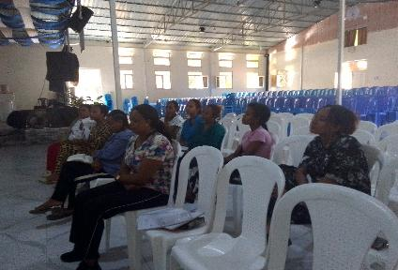
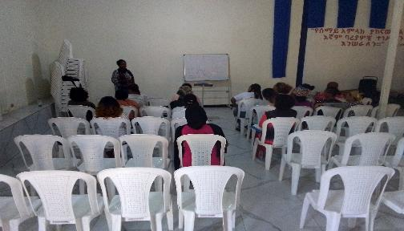
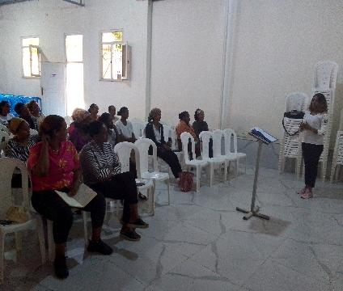
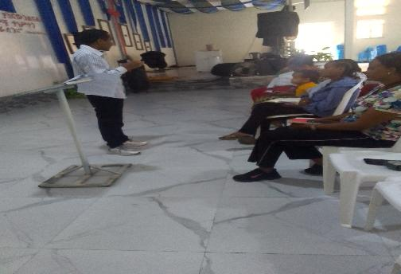
Training Session (Photo)

Slide 8
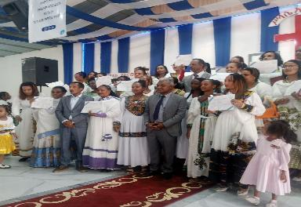
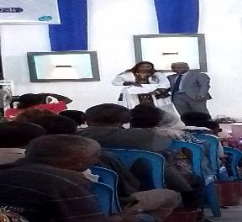
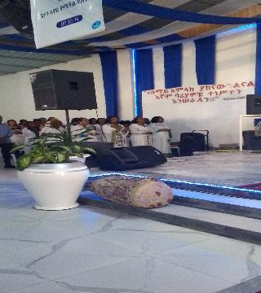
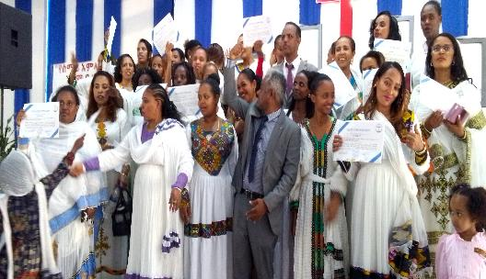
Parents/Caregivers Graduation Day (Photo)

Slide 9
3. My Personal Experience as a Facilitator
As a facilitator, the experience was profoundly rewarding. We, the trainers, had to first internalize the ICDP principles ourselves, which was a deeply personal journey.
Then, we had the privilege of witnessing the principles come to life through the parents' engagement and reflection.
The experience was transformative for us because it allowed us to see firsthand how these concepts could change families from within.
I have four children….

Slide 10
4. Impact of the Program
The impact was significant. The training report's central focus was on the transformative, life-changing, and sustainable nature of the content.
We observed parents who were initially reserved become more open and engaged. The discussions shifted from a purely theoretical understanding of "parental responsibility" to a practical application that brought joy and visible change to their families.
The parents gained confidence and a new perspective on their role in shaping their children's emotional landscape.

Slide 11
5. Most Important Sensitization Principles
Of the sensitization principles, establishing a close and trusting relationship with the caregiver and encouraging group participation are particularly important.
Establishing a close and trusting relationship is fundamental because it creates a safe environment for caregivers to be open and vulnerable about their parenting challenges. Without this foundation of trust, they may be unwilling to share their experiences or commit to the homework exercises. This principle is a prerequisite for all other learning to take place.
Group participation is equally vital because it validates the caregivers' experiences and promotes peer-to-peer learning. When caregivers share their examples, they realize they are not alone in their struggles. This shared experience builds a sense of community and provides a powerful source of motivation and encouragement that a facilitator alone cannot provide. It moves the learning from a one-way transfer of knowledge to a dynamic, shared process of discovery.

Slide 12
6. Adaptation and Reception in our Culture
The ICDP program was adapted by framing the principles within the context of Christian values and teachings (Protestant)
The reception was overwhelmingly positive because the program's universal principles were presented in a way that resonated with the parents' faith.
They saw the training not as a foreign concept but as a practical, faith-based guide to improving their family life.

Slide 13
7. Challenges During and After Implementation
Commitment: Parents needed to stay engaged throughout the eight-week program, which was sometimes difficult.
Logistics: Managing the implementation of a new program posed organizational challenges.
Sustaining the momentum: After training, keeping parents motivated to continue meeting and sharing experiences was crucial.
Long-term success depends on making ICDP principles a permanent part of parenting practices and spreading them within the community.

Slide 14
Stay Blessed!
Thank You!!

